Slide 1
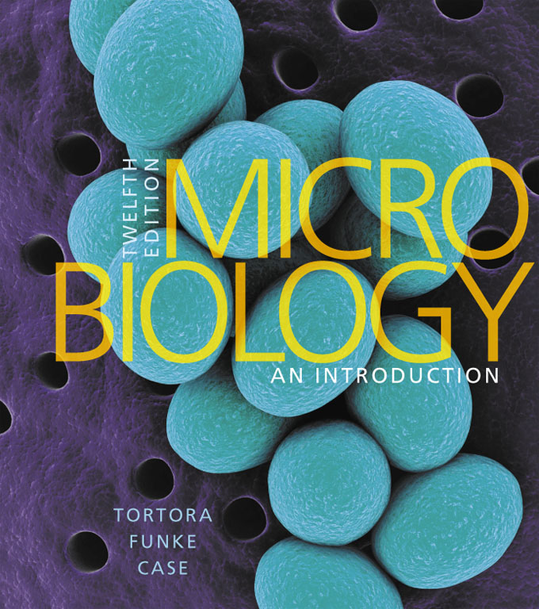
Microbiology an Introduction
Twelfth Edition
Chapter 26
Microbial Diseases of the Urinary and Reproductive Systems
Copyright © 2016 Pearson Education, Inc. All Rights Reserved

Slide 2
Leptospira Interrogans

Slide 3
Structure and Function of the Urinary System (1 of 2)
Learning Objective
26-1 List the antimicrobial features of the urinary system.

Slide 4
Structure and Function of the Urinary System (2 of 2)
Urinary system
Two kidneys
Two ureters
One urinary bladder
One urethra
Infection prevented by:
Valves that prevent backflow to the kidneys
Acidity of urine
Mechanical flushing

Slide 5
Figure 26.1 Organs of the human urinary system, shown here in the female

Slide 6
Check Your Understanding-1
Check Your Understanding
Does the pH of urine facilitate the growth of most bacteria? 26-1

Slide 7
Structure and Function of the Reproductive Systems (1 of 3)
Learning Objective
26-2 Identify the portals of entry for microbes into the female and male reproductive systems.

Slide 8
Structure and Function of the Reproductive Systems (2 of 3)
Female reproductive system
Two ovaries
Two uterine (fallopian) tubes
The uterus, including the cervix
The vagina
External genitals (vulva)

Slide 9
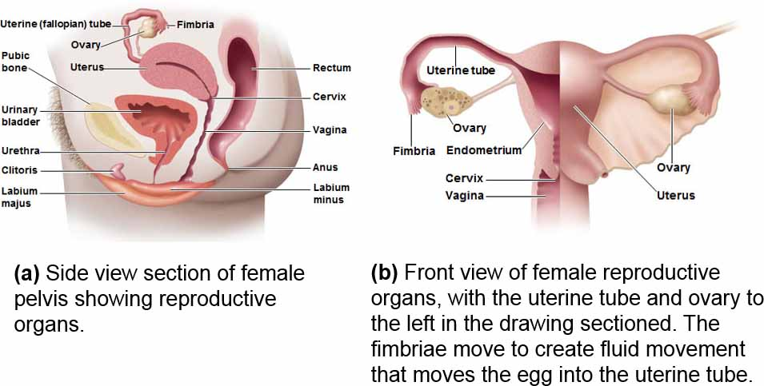
Figure 26.2 Female reproductive organs

Slide 10
Structure and Function of the Reproductive Systems (3 of 3)
Male reproductive system
Two testes
System of ducts
Epididymis
Ductus (vas) deferens
Ejaculatory duct
Urethra
Accessory glands
Penis

Slide 11
Figure 26.3 Male reproductive and urinary organs

Slide 12
Check Your Understanding-2
Check Your Understanding
Look at Figure 26.2. Is a microbe entering the female reproductive system (the uterus, etc.) necessarily also entering the bladder, causing cystitis? 26-2

Slide 13
Normal Microbiota of the Urinary and Reproductive Systems (1 of 2)
Learning Objective
26-3 Describe the normal microbiota of the upper urinary tract, the male urethra, and the female urethra and vagina.

Slide 14
Normal Microbiota of the Urinary and Reproductive Systems (2 of 2)
Urinary bladder and upper urinary tract are sterile
Predominant microbes of the vagina:
Lactobacilli
Produce H₂O₂ and lactic acid
Growth promoted by estrogen
Streptococci, anaerobes, some gram-negatives
Candida albicans yeast
Male urethra is usually sterile

Slide 15
Check Your Understanding-3
Check Your Understanding
What is the association between estrogens and the microbiota of the vagina? 26-3

Slide 16
Bacterial Diseases of the Urinary System (1 of 2)
Learning Objectives
26-4 Describe the modes of transmission for urinary and reproductive system infections.
26-5 List the microorganisms that cause cystitis, pyelonephritis, and leptospirosis, and name the predisposing factors for these diseases.

Slide 17
Bacterial Diseases of the Urinary System (2 of 2)
Urethritis
An inflammation of the urethra
Cystitis
An inflammation of the urinary bladder
Ureteritis
Infection of the ureters
Pyelonephritis
An inflammation of one or both kidneys
7 million urinary tract infections annually
Most due to Escherichia coli

Slide 18
Cystitis
Commonly caused by E. coli; also Staphylococcus saprophyticus
Dysuria (difficult or painful urination); pyuria
Eight times more common in women than men
Due to the short length of the urethra
Diagnosis: >100 CFU/ml of potential pathogens and a positive leukocyte esterase (LE) test
Treatment with trimethoprim-sulfamethexazole

Slide 19
Pyelonephritis
75% of cases caused by E. coli
Fever and back or flank pain
Generally results in bacteremia
Can form scar tissue in kidneys and become life- threatening
Diagnosis: >10,000 CFU/ml and a positive LE test
Treatment with cephalosporin

Slide 20
Leptospirosis
Caused by Leptospira interrogans
Fine spiral; stains poorly; obligate aerobe
Transmitted by skin/mucosal contact from urine-contaminated water from domestic or wild animals
Headaches, muscular aches, fever
Kidney failure (Weil's disease)
Pulmonary hemorrhagic syndrome
Diagnosed with a rapid serological test
Treatment with doxycycline

Slide 21
Figure 26.4 Leptospira Interrogans, the Cause of Leptospirosis

Slide 22
Diseases in Focus: Bacterial Diseases of the Urinary System
A 20-year-old woman feels a stinging sensation when urinating and feels an urgent need to urinate, even if very little urine is excreted. Lactose-fermenting, gram-negative rods are cultured from her urine.
Can you identify infections that could cause these symptoms?

Slide 23
Diseases in Focus 26.1 (1 of 2)

Slide 24
Diseases in Focus 26.1 (2 of 2)
Disease | Pathogen | Symptoms | Diagnosis | Treatment
Cystitis (urinary bladder infection) | Escherichia coli, Staphylococcus saprophyticus | Difficulty or pain in urination | .100 CFU/ml potential pathogens and + LE test | Trimethoprimsulfamethoxazole
Pyelonephritis (kidney infection) | Primarily E. coli | Fever; back or flank pain | .104 CFU/ml And + 1 LE test | Cephalosporin
Leptospirosis (kidney infection) | Leptospira interrogans | Headaches, muscular aches, fever; kidney failure a possible complication | Serological test | Doxycycline

Slide 25
Check Your Understanding-4
Check Your Understanding
Why is urethritis, an infection of the urethra, frequently preliminary to further infections of the urinary tract? 26-4
Why is E. coli the most common cause of cystitis, especially in females? 26-5

Slide 26
Bacterial Diseases of the Reproductive Systems (1 of 2)
Learning Objective
26-6 List the causative agents, symptoms, methods of diagnosis, and treatments for gonorrhea, nongonococcal urethritis (NGU), pelvic inflammatory disease (PID), syphilis, lymphogranuloma venereum (LGV), chancroid, and bacterial vaginosis.

Slide 27
Bacterial Diseases of the Reproductive Systems (2 of 2)
Sexually transmitted diseases (STDs)
Also known as sexually transmitted infections (STIs)
Often no signs or symptoms
Over 30 types of infections
15 million new cases in the United States annually
Treatment with antibiotics and prevented with condoms

Slide 28
Big Picture: STI Home Test Kits (1 of 2)
Collect samples at home and mail to a lab
Screens for chlamydia, gonorrhea, and trichomoniasis
Results in 1–2 weeks
Positive tests receive referrals to clinics
Test for HIV
OraQuick: oral test
Test for urinary tract infections
Uritest dipstick test

Slide 29
Big Picture pg. 752

Slide 30
Big Picture: STI Home Test Kits (2 of 2)
Pros of at-home testing
More cases are diagnosed
Better access for patients
Quicker treatment
Cons of home-testing
Cost
Privacy
Not all home test kits are equally accurate

Slide 31
Big Picture pg. 753

Slide 32
Gonorrhea (1 of 3)
Caused by Neisseria gonorrhoeae
Gram-negative diplococcus
300,000 cases in the United States annually
Attaches to the epithelial mucosa by the fimbriae
Invades the spaces between the columnar epithelial cells
Causes inflammation
Forms pus
Pharyngeal gonorrhea and anal gonorrhea

Slide 33
Figure 26.5a The U.S. Incidence and Distribution of Gonorrhea

Slide 34
Figure 26.5b The U.S. Incidence and Distribution of Gonorrhea

Slide 35
Gonorrhea (2 of 3)
Symptoms
Men: painful urination and discharge of pus; epididymitis
Women: fewer symptoms; pelvic inflammatory disease
If left untreated, may disseminate and become systemic
Endocarditis
Meningitis
Arthritis
Ophthalmia neonatorum: infant blindness due to a gonorrheal infection of the eyes

Slide 36
Figure 26.6 Pus-Containing Discharge from the Urethra of a Man with an Acute Case of Gonorrhea

Slide 37
Gonorrhea (3 of 3)
No adaptive immunity
Antigenic variability
Opa proteins bind to T cell receptors, preventing activation and immunological memory
Diagnosis with Gram stain, ELISA, or monoclonal antibodies
Treatment first with cephalosporins
Fluoroquinolones not recommended due to resistance

Slide 38
Figure 26.7 A Smear of Pus from a Patient with Gonorrhea

Slide 39
Clinical Focus 26.1

Slide 40
Nongonococcal Urethritis (NGU)
Nonspecific urethritis (NSU)
Any inflammation of the urethra not caused by N. gonorrhoeae
Caused by:
Chlamydia trachomatis
Mycoplasma hominis
Ureaplasma urealyticum
Painful urination and watery discharge; often asymptomatic; pelvic inflammatory disease (PID) in women
Diagnosis: culture or PCR
Treatment with doxycycline and azithromycin

Slide 41
Pelvic Inflammatory Disease (PID)
Extensive bacterial infection of the female pelvic organs
Polymicrobial infection, usually:
N. gonorrhoeae
C. trachomatis
Chronic abdominal pain
Salpingitis: infection of the uterine tubes
Most serious form of PID
Scarring can cause infertility or ectopic pregnancy
Treatment with doxycycline and cefoxitin

Slide 42
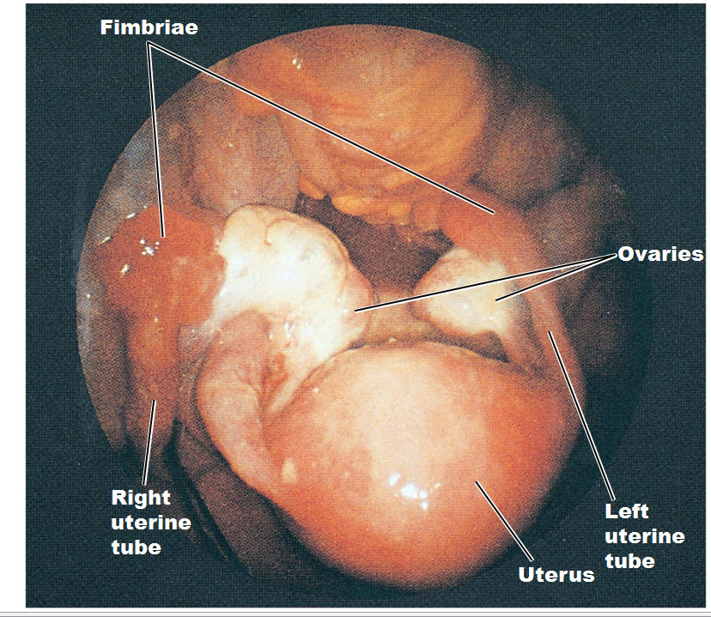
Figure 26.8 Salpingitis

Slide 43
Syphilis (1 of 4)
Caused by Treponema pallidum
Gram-negative spirochete
Grows slowly in cell culture
Invades the mucosa or through skin breaks and enters the bloodstream
Induces an inflammatory response
Some strains cause yaws
Skin disease is not sexually transmitted
Stable incidence in the United States

Slide 44
Figure 26.9 Treponema Pallidum, the Cause of Syphilis

Slide 45
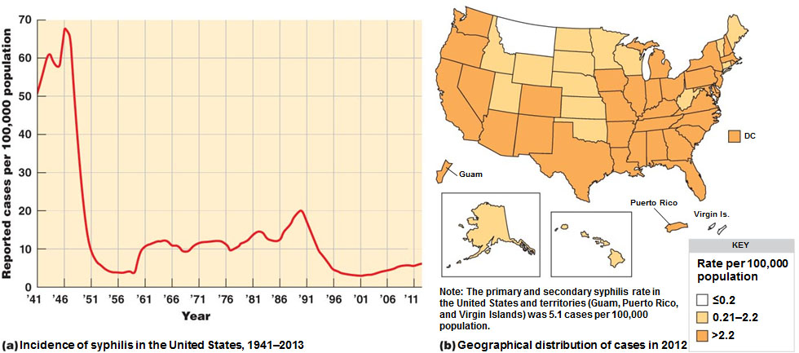
Figure 26.10 The U.S. Incidence and Distribution of Primary and Secondary Syphilis

Slide 46
Syphilis (2 of 4)
Primary stage
Chancre at the site of infection about 3 weeks after exposure
Painless and highly infectious
Disappears after 2 weeks
Secondary stage
Skin and mucosal rashes, especially on the palms and soles
Due to an inflammatory response
Latent period
No symptoms

Slide 47
Syphilis (3 of 4)
Tertiary stage
Appear years after latency
Due to cell-mediated immune reactions
Gummatous syphilis: gummas on many organs
Cardiovascular syphilis: weakens the aorta
Neurosyphilis: affects the CNS; dementia
Congenital: neurological damage to the fetus

Slide 48
Figure 26.11 Characteristic Lesions Associated with Various Stages of Syphilis

Slide 49
Syphilis (4 of 4)
Microscopic tests
Direct fluorescent-antibody test (DFA-TP) with monoclonal antibodies
Nontreponemal serological tests
Slide agglutination VDRL test
Rapid plasma reagin (RPR) test
Treponemal-type serological tests
Enzyme immunoassay (EIA)
Fluorescent treponemal antibody absorption test (FTA-ABS)
Treatment with benzathine penicillin

Slide 50
Lymphogranuloma Venereum (LGV)
Caused by C. trachomatis
Infects the lymphoid tissue
Regional lymph nodes become enlarged and tender
Discharge of pus and scarring
Diagnosis with blood test for antibodies to the organism
Treatment with doxycycline

Slide 51
Chancroid (Soft Chancre)
Caused by Haemophilus ducreyi
Gram-negative rod
Associated with drug use
Painful ulcers of the genitals and swollen lymph nodes in the groin
Factors in the sexual transmission of HIV
Treatment with azithromycin or ceftriaxone

Slide 52
Bacterial Vaginosis
Caused by Gardnerella vaginalis
Pleomorphic gram-negative rod
Vaginitis: inflammation of the vagina due to infection
Vaginosis: no sign of inflammation
pH above 4.5, fishy odor, copious frothy discharge
Clue cells
Sloughed-off vaginal epithelial cells covered with a biofilm of G. vaginalis
Treatment with metronidazole

Slide 53
Figure 26.12 Clue cells

Slide 54
Check Your Understanding-5
Check Your Understanding
Why is the disease condition of the female reproductive system, principally featuring growth of Gardnerella vaginalis, termed vaginosis rather than vaginitis? 26-6

Slide 55
Viral Diseases of the Reproductive Systems
Learning Objective
26-7 Discuss the epidemiology of genital herpes and genital warts.

Slide 56
Genital Herpes
Caused by herpes simplex virus type 2 (HSV–2)
In the United States, 1 in 4 over age 30 are infected
Painful vesicles on the genitals; painful urination
Heals within 2 weeks
Recurrences from viruses latent in nerve cells
Due to menstruation, emotional stress, or illness
Diagnosis via culture or PCR
No cure; suppression and management with acyclovir, famciclovir, and valacyclovir

Slide 57
Figure 26.13 Genital Herpes: Initial Visits to Physicians' Offices, United States, 1966 to 2012

Slide 58
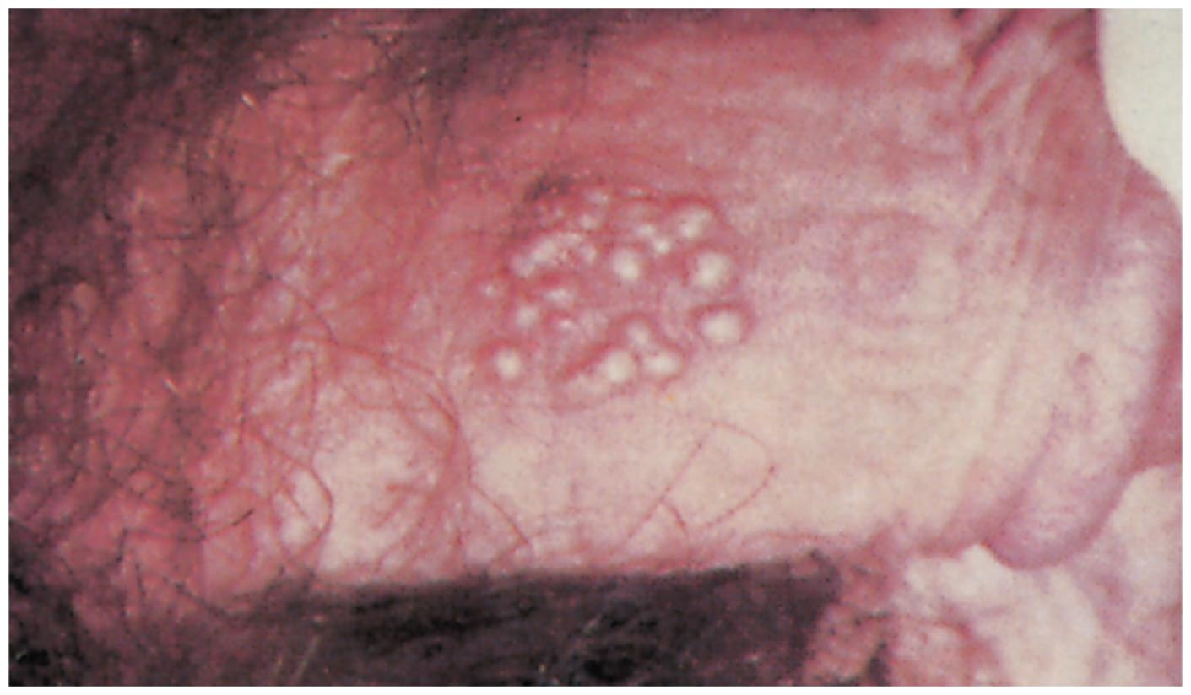
Figure 26.14 Vesicles of Genital Herpes on a Penis

Slide 59
Neonatal Herpes
Herpesvirus crosses the placental barrier and infects the fetus
Damages the CNS, developmental delays, blindness, hearing loss
Survival rate of 40%
Newborns infected from HSV exposure during delivery
Diagnosed by PCR tests and fluorescent antibody tests
Treatment with intravenous acyclovir

Slide 60
Genital Warts
Also known as condyloma acuminata
Caused by human papillomaviruses
25% of 14- to 59-year-old women in the United States are infected
Visible warts caused by serotypes 6 and 11
Serotypes 16 and 18 cause cervical cancer
Kills 4000 women in the United States annually
Treatment via removal of warts; podofilox and imiquimod
Prevention with the Gardasil and Cervarix vaccines

Slide 61
Figure 26.15 Genital Warts on a Vulva

Slide 62
Check Your Understanding-6
Check Your Understanding
Both genital herpes and genital warts are caused by viruses; which one is the greater danger to a pregnancy? 26-7

Slide 63
Fungal Disease of the Reproductive Systems
Learning Objective
26-8 Discuss the epidemiology of candidiasis.

Slide 64
Candidiasis
Caused by C. albicans
Grows on the mucosa of the mouth, the intestinal tract, and the genitourinary tract
Due to opportunistic overgrowth caused by:
Antibiotic use
Diabetes
Hormones
Oral candidiasis: thrush
Vulvovaginal candidiasis: vaginitis
Yeasty, thick, yellow discharge
Treatment with clotrimazole or fluconazole

Slide 65
Check Your Understanding-7
Check Your Understanding
What changes in the vaginal bacterial microbiota tend also to favor the growth of the yeast Canidida albicans? 26-8

Slide 66
Protozoan Disease of the Reproductive Systems
Learning Objectives
26-9 Discuss the epidemiology of trichomoniasis.
26-10 List reproductive system diseases that can cause congenital and neonatal infections, and explain how these infections can be prevented.

Slide 67
Trichomoniasis
Caused by Trichomonas vaginalis
Normal inhabitant of the vagina and urethra
Grows when normal acidity of the vagina is disturbed
Irritation and a profuse foul, greenish yellow frothy discharge
Diagnosis with microscopic identification or a DNA probe
Treatment with metronidazole

Slide 68
Figure 26.16 Trichomonas Vaginalis Adhering to the Surface of an Epithelial Cell in a Cell Culture Preparation

Slide 69
The TORCH Panel of Tests
Panel of tests that screens for antibodies to infections in pregnant women
Toxoplasmosis
Other (such as syphilis, hepatitis B, enterovirus, Epstein-Barr virus, varicella-zoster virus)
Rubella
Cytomegalovirus
Herpes simplex virus

Slide 70
Diseases in Focus: Microbial Diseases of the Reproductive System
A 26-year-old woman has abdominal pain, painful urination, and fever. Cultures grown in a high-CO₂ environment reveal gram-negative diplococci.
Can you identify infections that could cause these symptoms?

Slide 71
Diseases in Focus 26.3 (1 of 3)

Slide 72
Diseases in Focus 26.3 (2 of 3)
Disease | Pathogen | Pathogen | Treatment
BACTERIAL DISEASES | blank | blank | blank
Gonorrhea | Neisseria gonorrhoeae | Men: painful urination and discharge of pus. Women: few symptoms but possible complications, such as PID. | Cephalosporins
Nongonococcal Urethritis (NGU) | Chlamydia trachomatis, Mycoplasma hominis, Ureaplasma urealyticum | Painful urination and watery discharge. In women, possible complications, such as PID. | Doxycycline, azithromycin
Pelvic Inflammatory Disease (PID) | N. gonorrhoeae, C. trachomatis | Chronic abdominal pain; possible infertility | Doxycycline and cefoxitin
Syphilis | Treponema pallidum | Initial sore at site of infection, later skin rashes and mild fever; final stages may be severe lesions, damage to cardiovascular and nervous systems. | blank
Lymphogranuloma Venereum (LGV) | C. trachomatis | Swelling in lymph nodes in groin | Doxycycline
Chancroid (Soft Chancre) | Haemophilus ducreyi | Painful ulcers of genitals; swollen lymph nodes in groin | Erythromycin; ceftriaxone
Bacterial Vaginosis | See Diseases in Focus 26.2 page 764 | blank | blank

Slide 73
Diseases in Focus 26.3 (3 of 3)
Disease | Pathogen | Pathogen | Treatment
VIRAL DISEASES | blank | blank | blank
Genital Herpes | Herpes simplex virus type 2; HSV type1 | Painful vesicles in genital area | Acyclovir
Genital Warts | Human papillomaviruses | blank | blank
AIDS | See Chapter 19, pp. 534–544 | blank | blank
FUNGAL DISEASE | blank | blank | blank
Candidiasis | See Diseases in Focus 26.2, page 764 | blank | blank
PROTOZOAN DISEASE |  | blank | blank
Trichomoniasis | See Diseases in Focus 26.2, page 764 | blank | blank

Slide 74
Check Your Understanding-8
Check Your Understanding
What are the symptoms of the presence of Trichomonas vaginalis in the male reproductive system? 26-9
What is the intent of the TORCH panel of tests? 26-10

